Slide 1
Offensive & Defensive & Forensic Techniques for Determining Web User Identity
Part 1
Zachary Zebrowski
zak@freeshell.org
Approved for Public Release: 12-3046. Distribution Unlimited

Slide 2
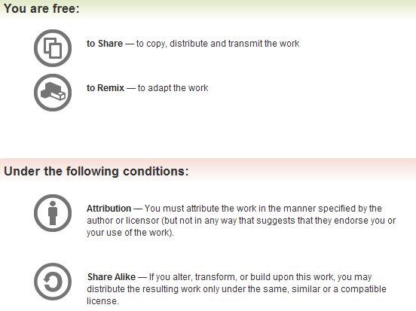
All materials is licensed under a Creative Commons “Share Alike” license.
http://creativecommons.org/licenses/by-sa/3.0/

Slide 3
Welcome!

Slide 4

Let’s introduce one another…
I’m Zak Zebrowski
Forensic Database Engineer / “Data Miner” / Perl guy

Slide 5
Class Outline
Introduction
Characteristics of connecting to the internet
Internet Networking Background
Offensive Ways to determine a web user identity
Defensive ways to prevent determining a web user identity from the end user’s perspective
Additional Tasks from those above
Forensic Database Analysis
Forensic Web Log Analysis
Finish

Slide 6
Introduction
Why bother?
  To determine who visits your website on the internet
    Your bank wants to know if I’m in the US, or in the UK
  To hide who you are on the internet.
  To determine forensically who visited your website after some event happened.
  Cool! I want to be an 31337 H4x0r
    Not exactly. Everything in this presentation is old. New techniques evolve over time.

Slide 7
Ethics
Reminder: Use what you learn here for Good not Evil.
I am not a lawyer.
What you do is at your own risk.

Slide 8
Characteristics of Internet Connections
Questions to ask:
  What devices connect to the internet?
  When do you access the internet?
  How are you connecting?
Why bother?
  You can’t escape these characteristics, regardless of what you try to do…

Slide 9
What devices connect to the internet?
Almost easier to say what device doesn’t connect.
Here’s a list of things known to connect to the internet:
  Computer
  Cell Phone
  SIP Phone (VOIP)
  Apple TV / Google TV
  Your thermostat (Multiple companies)
  Your alarm clock (Chumby)
  Your car (Chevy Volt)
  Your door lock (Schalage)
  Your picture frame
  Your camera (EYEFI sd card)
  Your watch ( pebble ; impulse ; etc)
&& Each of these devices can be identified through various means
  nmap –O –V 192.168.1.1

Slide 10
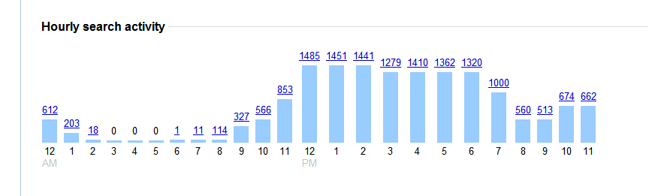
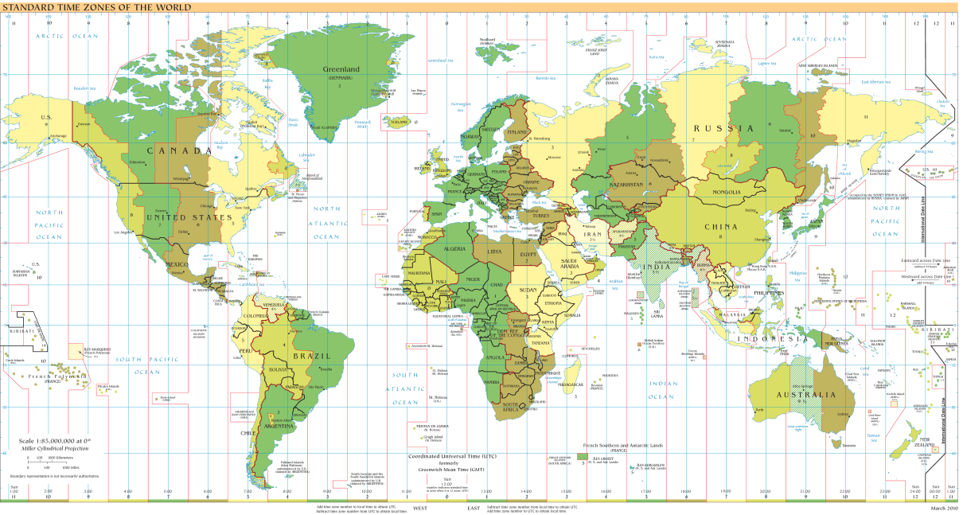
When do you connect?
Source: google.com analytics (for my personals search history) && http://en.wikipedia.org/wiki/File:Timezones2010.png (licensed public domain).

Slide 11
How are you connecting?
Dial Up
Cellular Phone Device
DSL / Cable
FIOS
Other ways:
  Satellite connections
  Radio connections

Slide 12
Satellite Example
Designed for remote areas where other options not available
  See http://www.wildbluesales.com/ as an example
  As low as $39.95 / month ; 1mbs download ; other plans available
    Valid as of 6/28/12
Notes:
Source: http://www.directv.com/DTVAPP/content/directv/internet

Slide 13
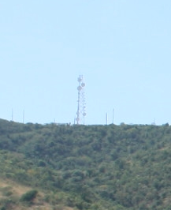
Radio Connections
Found in the US Virgin Islands / PR
Mountainous terrain; good weather (minus hurricanes); fixed coverage area; somewhat poor utility infrastructure.
http://www.ackley.vi/
  Photo source personal photos
Notes:
Source Ackley communications website && personal photos.

Slide 14
Characteristics of Internet Connections Summary
  What devices connect to the internet?
    Almost anything, but they’re detectable
  When do you access the internet?
    Can generally detect what time zone you’re in.
  How are you connecting?
    Can be summarized if speed is detected.
Why bother?
  You can’t escape these characteristics, regardless of what you try to do…

Slide 15
Basic Internet Technology Background
What is an IP Address?
How are IP Addresses Assigned?
What is a NATed / Private IP Address?
What is a Port?

Slide 16
What is an IP Address?
An IP Address is a unique identifier that allows you to connect to the internet.
  Conceptually, it’s similar to your street address for your house

Slide 17
What is a NATed / Private IP Address?
There are a limited number of IP Addresses available. A ISP may assign you a particular IP Address, but not enough for all of your personal devices. “NATing” allows you to have many personal devices, while using only one public IP Address on the internet.
  Conceptually, it’s similar to an apartment number in an apartment complex.
A private IP Address is simply a non-routable IP Address on the internet, which the home router gives to local machines, and via NAT routing connects to the internet.

Slide 18
How are IP Addresses Assigned?
IP Address ranges (a set of IP Addresses) are assigned to an ISP (Internet Service Provider) by a registrar. The specific registrar is dependent upon what domain you are purchasing for, though generally this is treated based upon the region in where you live.
A particular ISP can then assign you a particular IP Address for your router.
  But the private IP Address space is only assigned by your router.

Slide 19
What is a port?
A port is simply a number, which allows two computer programs on different computers to communicate with one another.
Generally, certain services run on specific port numbers, however, a programmer can arbitrarily set what ports to connect to if there is a good reason too.
  Port 22 for ssh traffic
  Port 80 for http traffic

Slide 20
Questions?
You just survived the “boring” part.
5 Minute Coffee / Bathroom break.
When we come back, we will start with offensive techniques to determine who a user is.

Slide 21
Identifying Techniques
These are server techniques to determine who you are.
IP Geolocation
What your browser expose when you browse to a web page.

Slide 22
IP Geolocation
IP Geolocation is the name for the technology to go from an IP Address to a physical location. Companies, and open source utilities, provide this IP Geolocation information in various formats to download off of the internet for use within your internal applications.
  Note: Sources generally provide other attributes as well as just ip location information, such as domain name, isp, org, or similar. This is a by-product of the analysis they perform.

Slide 23
IP Geolocation – what does that mean?
For a given IP Addresses, I can tell you approximately where they are located, without using a network connection.
Also, I can generally tell your internet provider
  Verizon.com
  Yourbuissness.com
  Etc
I can use this to:
  Send you targeted internet ads
  Verify you have permission to view media content
  Verify you are in a country the same as your credit card

Slide 24
How does one create an IP Geolocation database?
Caveat: These only discuss how open source IP Geolocation techniques work, not commercial sources.
Ask the user
  Hostip.info
    Host name: pool-70-108-49-201.res.east.verizon.net.
    IP address: 70.108.49.201
    Location: UNITED STATES (change)
    http://www.hostip.info (12/18/10, 1/7/12)

Slide 25
How does one create an IP Geolocation database (2)?
Query registries
  We [Software77.net] use the registry assignments provided by the registrars. However discrepancies creep in especially in cases of large multinational companies who have their base of operation on one country and satellite offices in other countries. Typically what happens is that a company based in say, the United States, also has a branch in Africa or Asia.
    http://software77.net/faq.html (1/24/08)

Slide 26
Open Sources
Maxmind
  Country & City files (less accurate than paid version)
  http://www.maxmind.com
Hostip.info
  Community volunteers location, plus various automated features
  http://hostip.info
Software77.net
  Scrapes whois notifications of new domains
  Provides a “birth date” for a domain.
  http://software77.net/cgi-bin/ip-country/geo-ip.pl

Slide 27
Open Sources VS Commercial Sources
Open Source
  Less data fields
  Known algorithms
  Unique attributes
    Hostip.info is user contributed – could be interesting?
    Software77.net has daily location updates.
  Free
    Convenient if you need to do this analysis infrequently
Commercial Data Sources
  Claimed Higher accuracy
  Dedicated staff
  Costs Money

Slide 28
IP Geolocation Caveats
Can only get to the most visible IP Address.
  No indication that a proxy is being used
  (unless a well known proxy)
Time frame
  Generally the data is delayed at least one month, plus time required to get the data into a usable format.
  IP Addresses can be re-allocated from ISP to ISP in a short period of time.
  Newly registered host names may not show up in a short amount of time
  About 1-2% change per month (http://www.maxmind.com/app/faq)
Domain name resolution is limited
  Multiple domain names can point to a single IP Address
“NATed” IP Addresses
  Where a user at home uses a broadband modem to connect externally to the internet. Behind the modem there may be many machines, but there is only one IP Address facing the internet.
  Alternatively, could be a rural ISP provider.

Slide 29
IPV6
Starting to be integrated.
  Currently “a small percentage” in any country hosts IPv6 servers.
    http://www.ripe.net/ripe/meetings/ripe-57/presentations/Colitti-Global_IPv6_statistics_-_Measuring_the_current_state_of_IPv6_for_ordinary_users_.7gzD.pdf or http://preview.tinyurl.com/b36qzo
    http://www.maxmind.com/app/ipv6

Slide 30
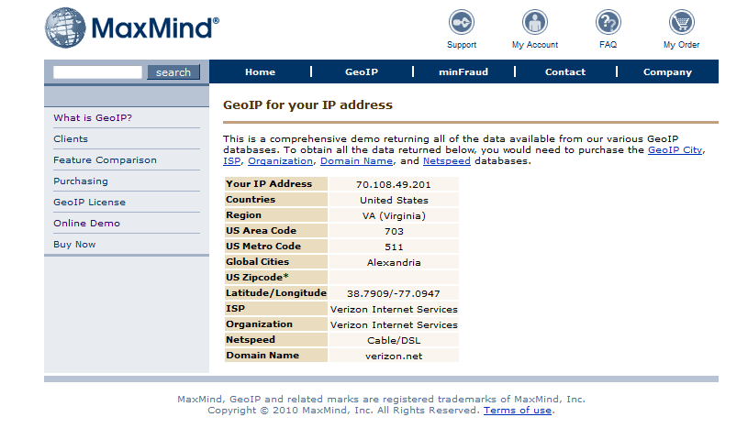
Example of information returned for my home connection in Arlington,VA

Slide 31
Lab 1 – IP Geolocation
First browse to google.com, and search for “what is my ip address”
  Record the IP Address.
  Do the same thing with a different device (cell phone)
Next, browse to
  http://hostip.info
  Enter the IP Address and press go.

Slide 32
What your browser exposes
By Default
By HTTP Cookies
By Scripting
By External Connections
Follow along and go to the various websites…

Slide 33
By Default
Your IP Address / host name
  REMOTE_ADDR : 70.108.107.180
  REMOTE_HOST : pool-70-108-107-180.res.east.verizon.net
User Agent (what web browser you use)
  HTTP_USER_AGENT : Mozilla/5.0 (Windows; U; Windows NT 6.0; en-US; rv:1.9.2.6) Gecko/20100625 Firefox/3.6.6 (.NET CLR 3.5.30729)
    Note language is exposed.
Cookies (if set)
  HTTP_COOKIE : __utma=145017023.1934880434.1277898848.1278891119.1278893601.5; __utmz=145017023.1277898848.1.1.utmcsr=(direct)|utmccn=(direct)|utmcmd
  This was set via a google analytics script I run to see who visits my main zak.freeshell.org page.
http://zak.freeshell.org/env.pl

Slide 34
By HTTP Cookies
Cookies were originally designed so that you could have a “stateful” web session for shopping.
A server sets a key value pair when returning a webpage or image. You send that key value pair with every request to that domain, until it expires.
Cookies only return information to the domain that you are visiting
  Note, though, if you embed an image from a different server, that server can set a separate cookie. This is called a third party cookie.

Slide 35
By Scripting
How to tell what company you’re from
How to tell if you’ve visited other sites (HREF color JavaScript tester)
JavaScript Location API (Where you are)
“Click Heat” – where you’ve clicked
Ever Cookie.js – Have I seen you before?

Slide 36
How to tell what company you’re from
Via http://panopticlick.eff.org/ (with many other attributes you can get from scripting)
Flash code identifies system installed fonts
  Do you have a “company “ font? See if you can find it!
Notes:
http://en.wikipedia.org/wiki/Panopticon - Panopticon from wikipeida: The Panopticon is a type of prison building designed by English philosopher and social theorist Jeremy Bentham in 1785. The concept of the design is to allow an observer to observe (-opticon) all (pan-) prisoners without the incarcerated being able to tell whether they are being watched, thereby conveying what one architect has called the "sentiment of an invisible omniscience."

Slide 37
What you’ve visited before script
Found in the wild.
Used to work.
  Last year Firefox / other browsers have been patched against this type of exploit.
Uses JavaScript to look at <A HREF=“”> html to see what the color of the link is , to see if it’s been visited before
Example: Visited | Not Visited
See http://www.techdirt.com/articles/20101130/21535012065/how-youporn-tries-to-hide-that-its-spying-your-browsing-history.shtml or http://preview.tinyurl.com/3yqbptk

Slide 38
JavaScript Location API
New as of 10 Febuary 2010
http://dev.w3.org/geo/api/spec-source.html
Will it work? It’s still a bit of a new feature, so it should on most browsers.
  See http://html5demos.com/ for html5 integration and http://html5demos.com/geo for a geo location example.
Often uses Wi-Fi to detect location (unless a mobile device and it uses GPS)

Slide 39
Sample Location Code
<HTML><BODY>
<SCRIPT TYPE="text/JavaScript">
function showMap(position) {
alert("Lat:" + position.coords.latitude + "," + "Long:" + position.coords.
longitude);
}
// One-shot position request.
if (navigator.geolocation){
navigator.geolocation.getCurrentPosition(showMap);
} else {
alert('No geolocation available. ');
}
</script>
</BODY></HTML>

Slide 40
Notes on Location
Browser to OS for location information
  Insert magic here in the OS level.
Location returned isWGS84 standard.
Can be off by a large distance
  I’m sometime geolocated to Baltimore instead of Arlington.
  When I was in Bedford, I was geolocated to south of Boston

Slide 41
“ClickHeat”
http://www.labsmedia.com/clickheat/index.html
Tracks where users click on your website via simple JavaScript.

Slide 42
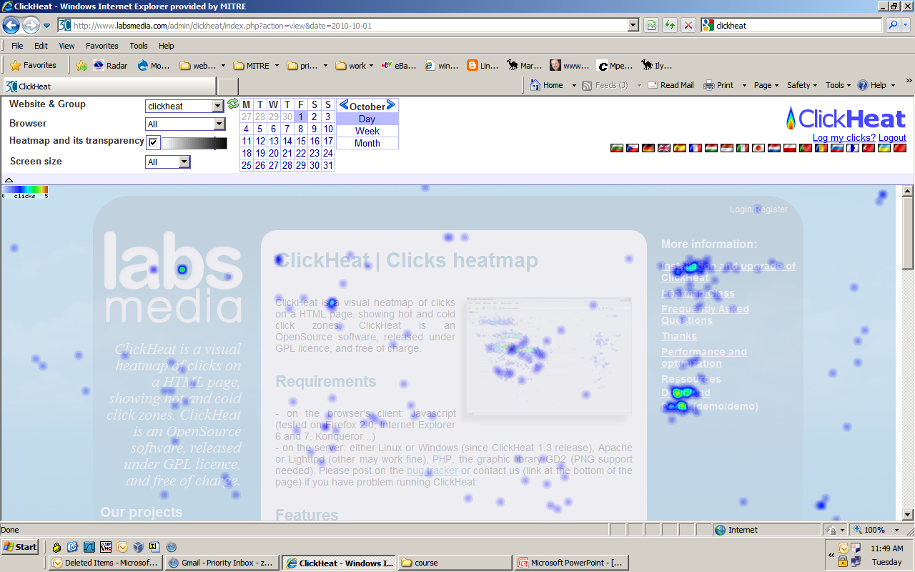
“ClickHeat” Demo slide

Slide 43
Evercookie.js
Uses HTML 5 features ; flash ; JavaScript; and many other techniques to create an “evercookie” that can’t be revoked*.
See http://samy.pl/evercookie/
*Easily anyways.
  http://arstechnica.com/security/news/2010/10/it-is-possible-to-kill-the-evercookie.ars
  http://preview.tinyurl.com/29ka7ba

Slide 44
By External Connections
Browsers allow for multiple types of connections
  For example: http ; ftp ; Microsoft shares ; etc.
By including a href link to a different type of connection, you may be bypassing proxy settings and thus exposing additional information about yourself.
  Possibly your username / domain
  Your real IP Address (because it’s not proxied.)
You can unknowingly request a different protocol by visiting a web page.
See http://www.defcon.org/images/defcon-17/dc-17-presentations/defcon-17-gregory_fleischer-attacking_tor.pdf or http://preview.tinyurl.com/brcg6ca

Slide 45
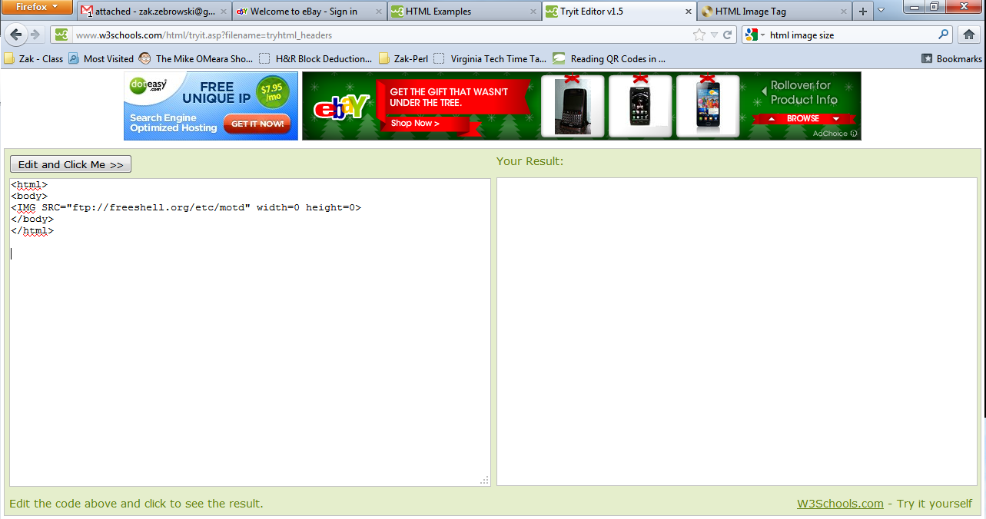
External Example – what you see

Slide 46
This is common!
This type of identification is profitable!
  Multiple companies are interested in “fingerprinting” PC’s so they have a permanent record of your machine’s web accesses.
  http://online.wsj.com/article/SB10001424052748704679204575646704100959546.html or http://preview.tinyurl.com/32c9frf

Slide 47
See also
http://waxy.org/2011/11/google_analytics/
  Google Analytics A Potential Threat to Anonymous Bloggers
https://github.com/michaelhans/derezzed-light
  Takes panopclick attributes via JavaScript, converts it to a browser key, and turns it into a logon mechanism for a website.

Slide 48
Questions?
Let’s have a break
When we get back, we start with ways of preventing these mechanisms from working…

