Slide 1
Offensive & Defensive & Forensic Techniques for Determining Web User Identity Part 2
Zachary Zebrowski
zak@freeshell.org
Approved for Public Release: 12-3046. Distribution Unlimited

Slide 2
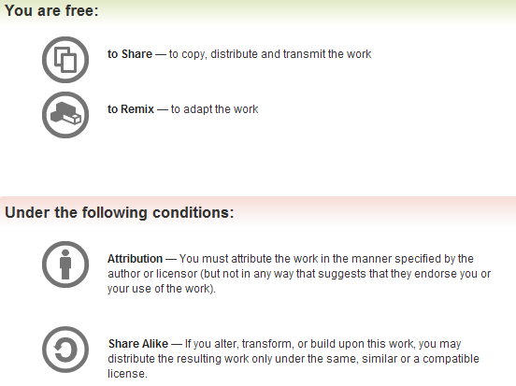
All materials is licensed under a Creative Commons “Share Alike” license.
http://creativecommons.org/licenses/by-sa/3.0/

Slide 3
Part 2 Outline
How to obfuscate where you’re coming from
How to protect against browser exposures
Important Caveats

Slide 4
Obfuscation Content
Simple Obfuscation
Borrowing a neighbors connection
Shell services
Cloud services
VPN Providers
Anonymizers
Tor
Others
Web browser “privacy” modes.
Email

Slide 5
Borrowing a neighbors open network connection
Easy to do (just select another Wi-Fi access point to connect too); free & plentiful (depending on neighborhood)
You need not be “next door”.
You can use antennas to extend ranges of your connection with an antenna up to 189 miles, or with a balloon (to overcome the shape of the earth) 260 miles with 6 watt amplifiers.
See http://en.wikipedia.org/wiki/Long-range_Wi-Fi
It is (generally) not legal to connect to a neighbors network connection and use it for illicit purposes.
It is (generally) not legal to “break” a neighbors “secured” wireless access point.
It is (generally) legal to use a neighbors connection which is not protected by a password, and use it for “basic incidental personal” use.
See: http://compnetworking.about.com/od/wirelessfaqs/f/legal_free_illicit.htm for more info about legalities. I am not a lawyer

Slide 6
REMINDER
Just because you can steal a Wi-Fi connection, it doesn’t mean you should.
Laws change.
I do not want to see you go to jail.
I am not a lawyer.

Slide 7
With that said…
According to a Wakefield Research / Wi-Fi Alliance poll, 32% of those polled admit to borrowing a neighbors Wi-Fi network

Slide 8
Shell Accounts
What’s a shell?
A shell is a name for a command interface, like MSDOS. Shell services are generally associated with Linux OS’s. Generally, they are hosted on a machine different from your own. (A simple method to obfuscate where you are coming from.)

Slide 9
Who provides shell accounts?
Freeshell.org
Longest & best “free” shell provider.
Cost: free, after a $1 donation to prevent spammers.
See also: http://sdf.org/?faq?MEMBERS?01 for “levels” of support.
Requires an upgrade to arpa status, a one time $36 dollar fee for outbound access
Web Hosters
http://www.slicehost.com ($240 / year)
http://www.pair.com ($71 to $20,388 year, depending on package used.)
Go Daddy ($50 / year to $179 / year depending on package used)
(Prices valid in 2010).
Your home PC
Use a dsl / cable connection ; install virtual box and your favorite Linux flavor

Slide 10
Cloud Services – create your own ssh box.
Amazon EC2 cloud
Another way to obfuscate where you’re coming from.
Costs money.
Requires a credit card.
Requires a valid phone number.
They will disable your account if you do enough “bad” stuff – for example: wikileaks.
Sort of a pain to create an account, sort of expensive after a while / understanding what costs money.

Slide 11
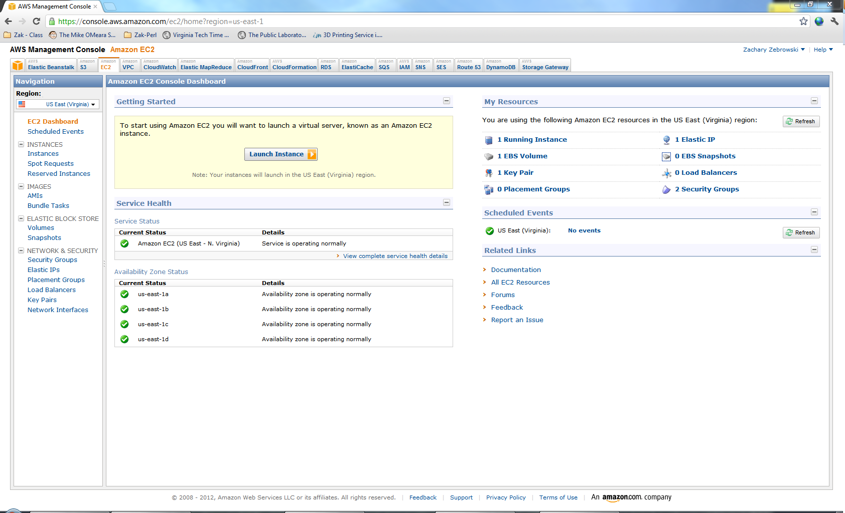

Slide 12
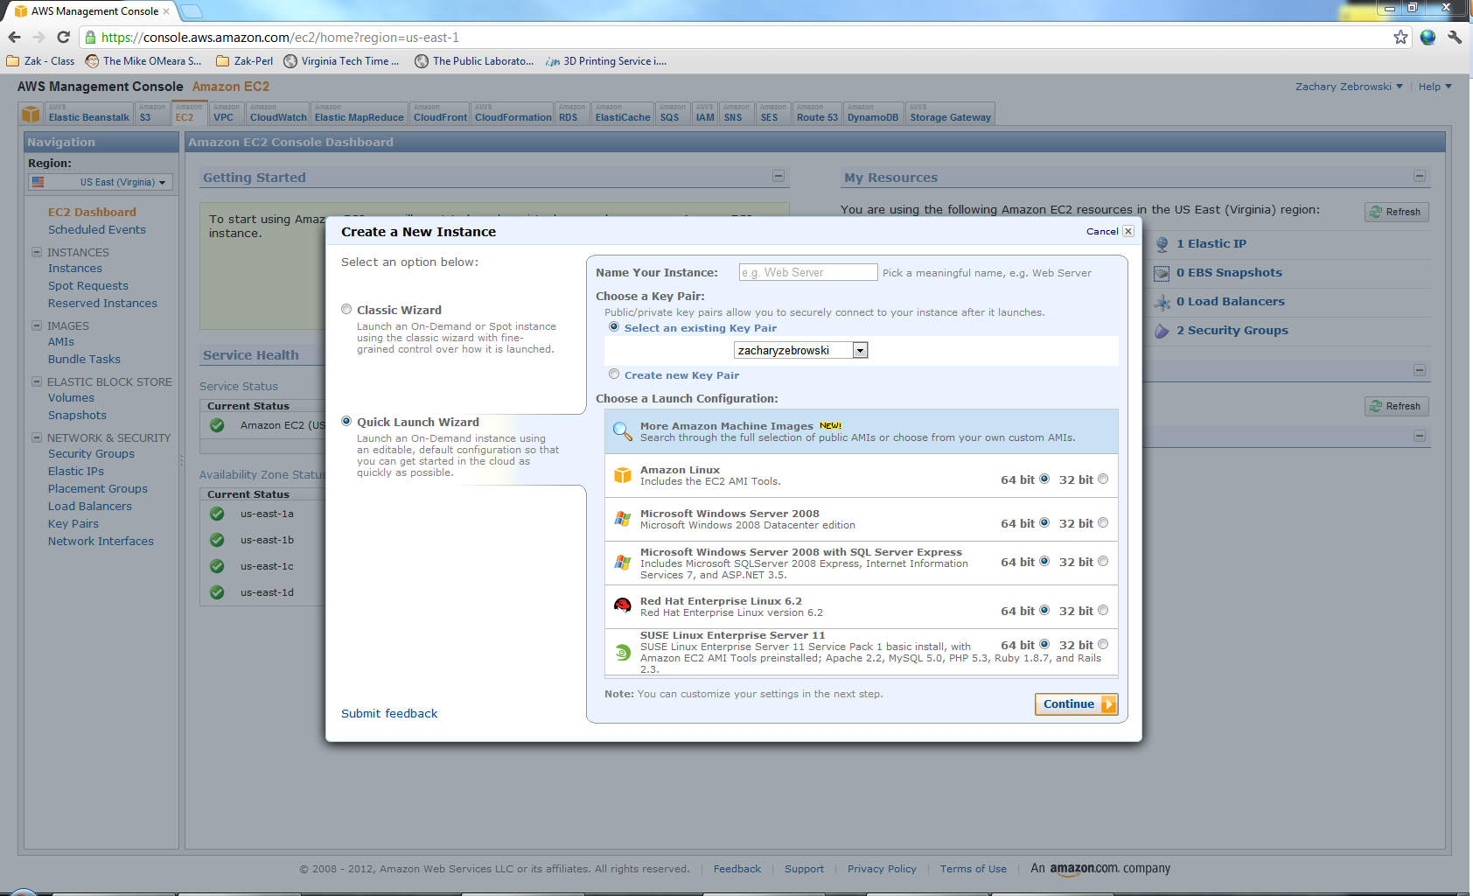

Slide 13
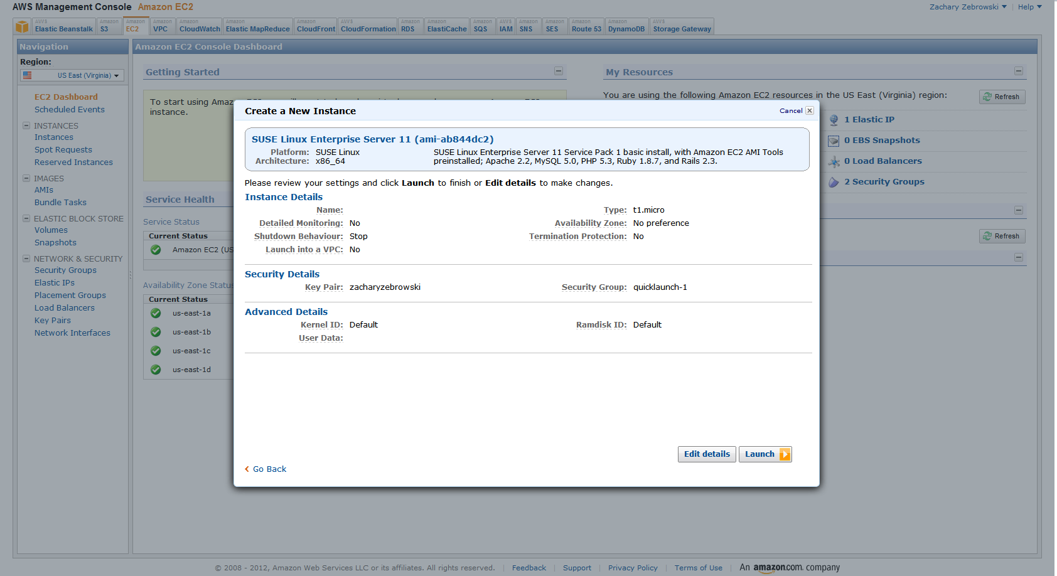

Slide 14
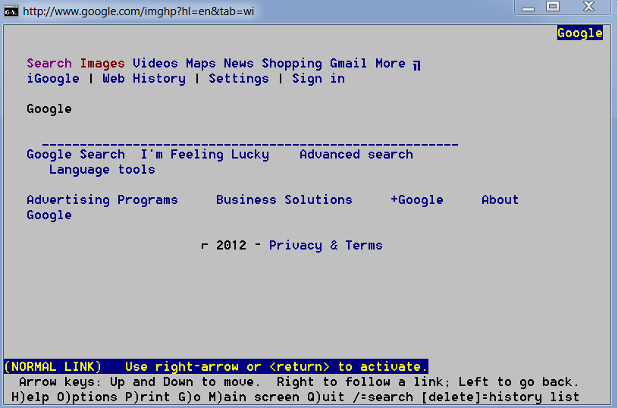
Web Browsing via a Shell Account: Lynx
Lynx is a simple text based web browser. A good tool to have if you’re browsing on the command line.

Slide 15
Lynx Cheat Sheet
Type lynx at command line. (Optionally with the URL you wish to go to).
Use the up & down arrow keys to browse around the web page.
Type G (for go) to go to another website.
Press return to follow a URL link.

Slide 16
Lynx Lab
Download & Install Lynx via http://lynx.isc.org/lynx2.8.7/index.html
Start, and G)o to http://www.google.com
Browse using <- -> /\ \/ pgup pgdown keys
To follow a link, hit return.

Slide 17
VPN Providers
VPN = Virtual Private Network
There are numerous VPN services available commercially.
(Including freeshell.org)

Slide 18
A note on mobile browsers that uses a proxy
Browsers on mobile devices have different headers
OperaMini – All traffic goes through opera-mini.net
Though it does include a HTTP_X_FORWARDED_FOR header with the client’s IP ADDRESS.
Which may not appear, depending on how you set up your logs.
Amazon silk hits a website twice, once from the client, once from the amazon cloud to “accelerate performance”.

Slide 19
Anonymizers
An anonymizer is a tool that allows you to improve your privacy and security on the internet.
Tor
We will talk in depth about this in a second.
Others
There are many.
Google “anonymous proxy”

Slide 20
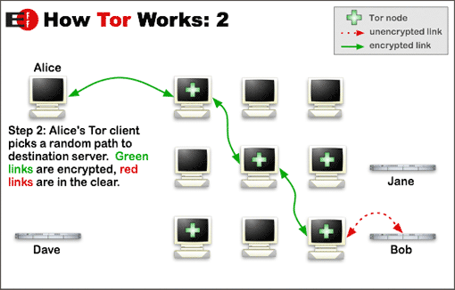
Tor - How it works
Source https://www.torproject.org/about/overview.html
Notes:
Source: https://www.torproject.org/about/overview.html

Slide 21
Tor – Summary Info
Tor is a socks proxy.
A new Tor circuit is created every 5 minutes by default.
Can be changed via configuration options
Runs on Windows / Linux / Mac / Android phone, etc.
Tor is a bit slow.
But better since the latest version

Slide 22
Tor - What services are available
Any TCP-based protocol
For any TCP-based protocol (telnet, ssh, nntp etc.), you can use TCP portmapping with 3proxy. For example, to map port 2200 of the local computer to port 22 (ssh) of my.ssh.server replace last string or add new string tcppm -i127.0.0.1 2200 my.ssh.server 22 to the 3proxy configuration from POP3. Now you can do ssh -p2200 127.0.0.1 to connect via SSH to my.ssh.server.
See https://trac.torproject.org/projects/tor/wiki/TheOnionRouter/TorifyHOWTO/Misc or http://preview.tinyurl.com/7pvwpnt

Slide 23
Tor Software Bundles
Software bundles for Windows / Mac / Linux allow for easy web browsing using tor.
Just double click on “Start Tor Browser” after you’ve downloaded the tor web bundle.
Also a chat client for IRC.

Slide 24
Tor – Hidden Web Sites
Tor allows clients and relays to offer hidden services. That is, you can offer a web server, SSH server, etc., without revealing your IP address to its users. In fact, because you don't use any public address, you can run a hidden service from behind your firewall.
Sites end in .onion, which isn’t routable on the internet, unless you’re running a tor client.
Some “hidden” sites include:
Custom search engine for searching .onion sites
Wikileaks
“One click and you will violate federal law” sites
During October 2011, hacktivist collective Anonymous downed the servers of Freedom Hosting as part of OpDarknet, a campaign against child pornography. Anonymous stated in media releases that Freedom Hosting had refused to remove such sites as "Lolita City" and "Hard Candy," which it found to contain 100 GB of child porn. Anonymous released 1500 user names from these sites and invited the FBI and Interpol to follow up. (Source Wikipedia article below)
DANGER: You’re entering the dark side of the web.
See http://en.wikipedia.org/wiki/.onion for various services

Slide 25
Tor – Hidden web sites part 2
Why did I mention this?
It’s good to know how wikileaks is hosted
It’s good to know in case you need to set up something
How to set up your own hidden service?
Follow tutorial:
https://www.torproject.org/docs/tor-hidden-service.html.en
Example service:
http://3g2upl4pq6kufc4m.onion/ ← Duck Duck Go search engine

Slide 26
See also
“How governments have tried to block tor”
http://www.youtube.com/watch?v=DX46Qv_b7F4
Tor Metrics
http://metrics.torproject.org/index.html

Slide 27
Web browser “privacy” modes
Allows you to browse for a session without cookies / other methods being used.
But in reality, there were some things that researchers were able to determine that still happened when you surfed via this technique.

Slide 28
Never Cookie
A Firefox plugin which “blocks” evercookies.
From anonymizer.com
http://www.evercookiekiller.com/
Does not work with current (v12) Firefox.
Designed to work with v11.

Slide 29
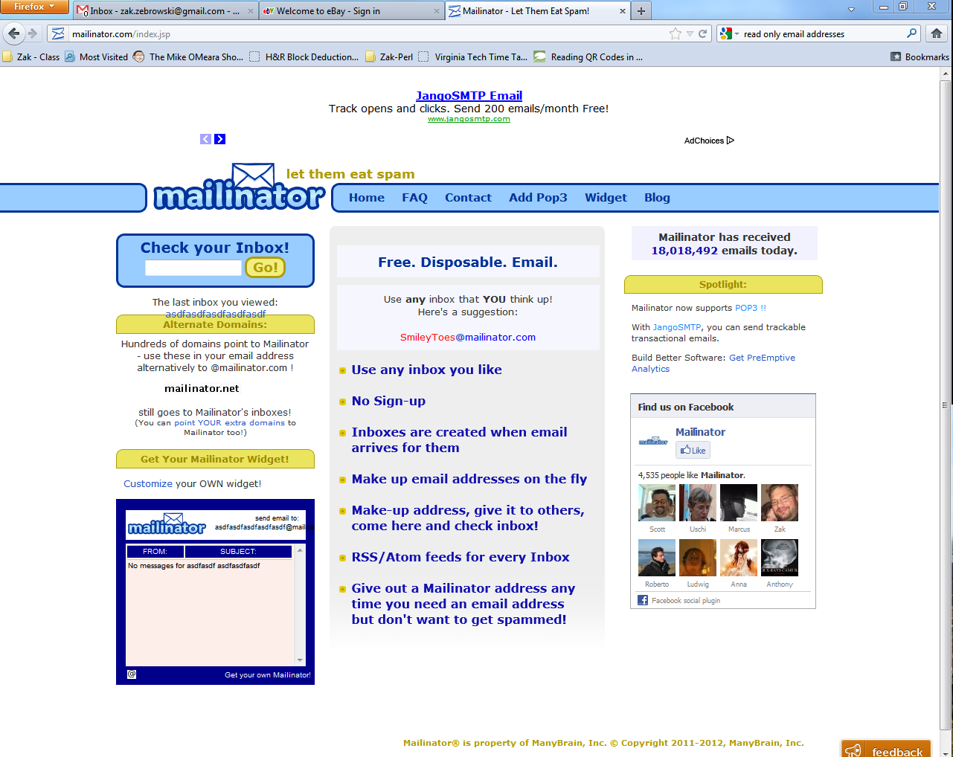
Email Obfuscation Techniques
Disposable email address
Mailinator has disposable email addresses
Randomly create a username and you have RSS / POP access to it. http://mailinator.com/index.jsp

Slide 30
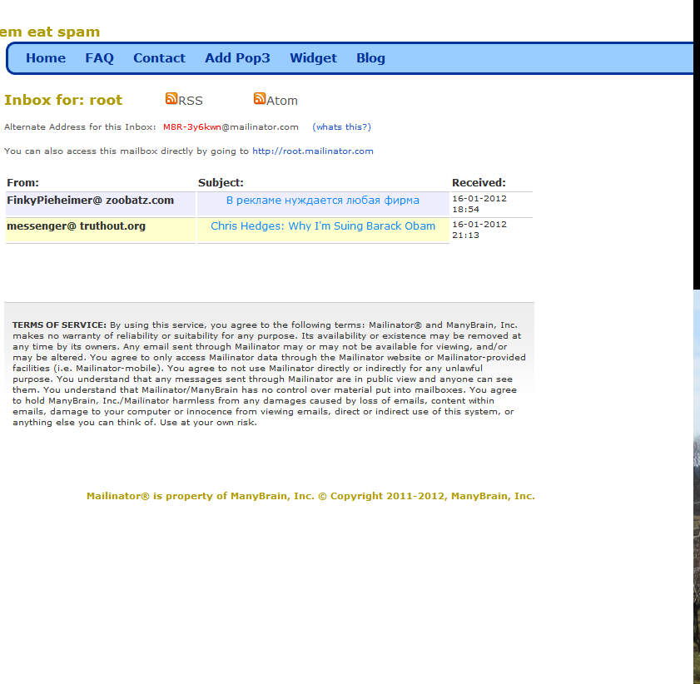
Sample message listing

Slide 31
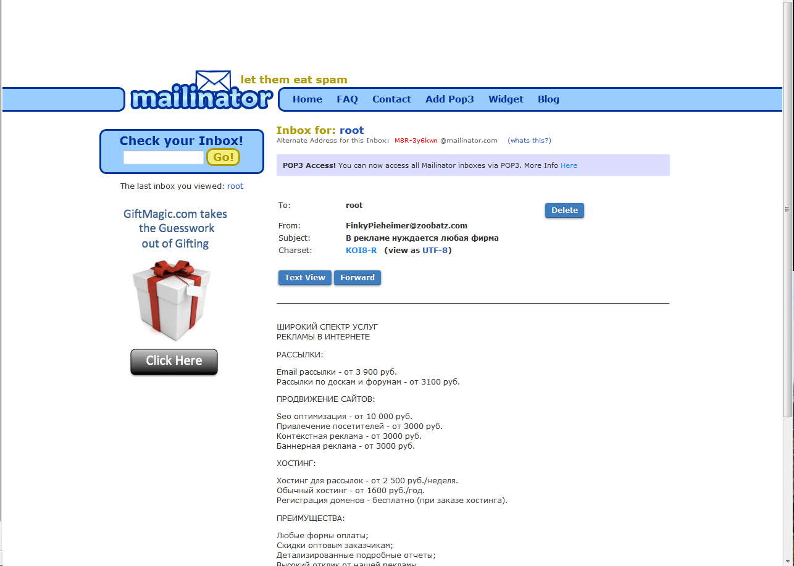
Sample email view

Slide 32
Can I Send Mail via mailinator address?
Maybe – depends on your ISP
How to configure:
http://borisbrodsky.com/2007/12/ubuntu-relay-email-server-thro-11.html

Slide 33
“Cypherpunk ; Mixmaster ; Mixminion” anonymous remailer email system
See: http://en.wikipedia.org/wiki/Anonymous_remailer
Easy to find a simple web page which you can anonymously send emails from a bogus email address to a real email address.

Slide 34
See also
https://burnnote.com/
Burn Note enables you to communicate online as privately as a spoken conversation.
Each Burn Note can be viewed only once and then it is deleted. Deleted Burn Notes are completely erased from the Burn Note servers so it impossible for anyone to retrieve them. More details are available on our FAQ and our technical information page.
Burn Note is useful for private communication. For example Burn Note can be used to securely send a password. It can also be used to have an off-the-record conversation with a friend.
(via spymuseum.org)

Slide 35
Lab 6 – Browsing via Tor
Browse in a non-tor browse to http://zak.freeshell.org/env.pl and note the variables shown.
Download the tor browsing bundle from https://www.torproject.org/download
Browse within the tor bundle to http://zak.freeshell.org/env.pl and note what has changed.
Browse to another site and see if you can tell any differences.
Also, try browsing to : http://3g2upl4pq6kufc4m.onion/ (Duck Duck go hidden service)

Slide 36
Lab 6B – Sending an email to mailinator.com
Open outlook (or your favorite online server – Gmail)
Send an email to: sampleforclass@mailinator.com
Browse to : http://mailinator.com/maildir.jsp?email=sampleforclass
wait for mail to show up.

Slide 37
Fixing / exploiting browser vulnerabilities
Proxy Filters
Pollipio Installed by default w/ tor
Using telnet to browse websites via proxy
Using timed queries
Use “new” features of html / JavaScript
Breaking Tor

Slide 38
Proxy Filters
Pollipio is a http filter, installed by default on Windows installations of TOR.
It will filter out ads, JavaScript, cookies, etc.
Other solutions exist for other types of OS’s.
But, as pollipo is known to be installed with TOR, you can configure attacks against the version of pollipo.

Slide 39
Telnet directly to a website
You can use the program telnet to request an arbitrary page on a website, using the GET syntax.
Example:
telnet host 80
Then:
GET /

Slide 40
Use timed queries
To defeat time zone analysis, consider writing a script that will randomly request the page of interest at a random time of day.

Slide 41
Use new features of JavaScript
If you can get the user to run a JavaScript command, you can then insert code that filters may not recognize.
For example, the new location JavaScript API still works through TOR on the android, because JavaScript is not filtered.
For older versions of TOR on android

Slide 42
Trick the browser to open a session not being proxied through TOR
If you can monitor another type of session (like ftp, or ldap request), and you can monitor that other session, you can determine the unproxied ip address.
Note! As of the latest version of the TOR browser bundles (as of April 2012), this trick does NOT work.
Unless you’re using “advanced” installation of TOR, which does NOT include a bundled browser, which might have incorrect settings set.

Slide 43
If you know someone is going through TOR, you can exploit it.
First, identify if the user is coming from a proxy, using IP Geolocation or other methods.
Check to see if any long term cookies are set for the client.
Know the version of the proxy filter
And see if that proxy has exploits.
Trick the browser into doing something it shouldn’t.
Trick the user into doing something it shouldn’t.
Statistical use of looking at TOR packets to determine what content is looking over TOR.
There was a presentation at a security conference about this.
Similar to the “phoneme” attack against Skype to determine what a user is saying
Statistical use of looking at a web browser connections to determine type of browser.
Written in a book entitled Silence on the Wire which mentions other active and passive techniques.
Setup then monitor unencrypted traffic on an end node.

Slide 44
Defeating IP Geolocation techniques
You can tell TOR what endpoint to use, if you need to come out of a certain country.
Use .exit special domain name to exit tor from a particular node.
Go to http://torstatus.blutmagie.de and pick a router name
Then browse to http://zak.freeshell.org/env.pl.someexit.exit where someexit is a router name.
You need to edit the config file to allow for exiting out of certain nodes as this is a security risk.

Slide 45
Questions?
Break!
See Also: http://en.wikipedia.org/wiki/Internet_privacy which is a good reference point too.
Next up – Forensic database & log analysis

